Slide 1
Team HappyBirthdayKevin!
Notes:
Hello, my name is Rose and I’m representing team Happy Birthday Kevin

Slide 2

“No one has ever become poor by giving.” ― Anne Frank
Notes:
First I’d like to begin with a quote.
No one has ever become poor by giving.
By anne frank.
This is just a little food for thought.
Now I’d like to introduce you to our product.

Slide 3

Best Guide
Helping other people help others.
Notes:
This is Best Guide. A play on words that rhymes with best buy. Haha.

Slide 4

Prompt #5 It is difficult for employees in a large company to seek help.
Notes:
A little bit of background. We chose Prompt #5 where we understood it as that
It’s difficult for employees to find expertise and mentorship within a large company.

Slide 5

Problem Domain
Assist employees who seek a certain expertise.
Break down the barrier inhibiting employees from helping each other.
Notes:
What we got out of that is that we can try to help assist employees who seek a certain expertise
And break down the barrier inhibiting employees from helping others.

Slide 6


Statistics from InternBridge.
Productivity
Retention
Promotion
Notes:
I just want to mention the impaction of mentorship in companies.
Most statistics I found mentioned that mentorship increased retention, productivity, and promotion.

Slide 7

Fairly new employee at a big company
Notes:
Before I actually show you the web application, I’d like to introduce you to paul.
Paul is a new employee at a big company. 4 months in. his computer receives the

Slide 8
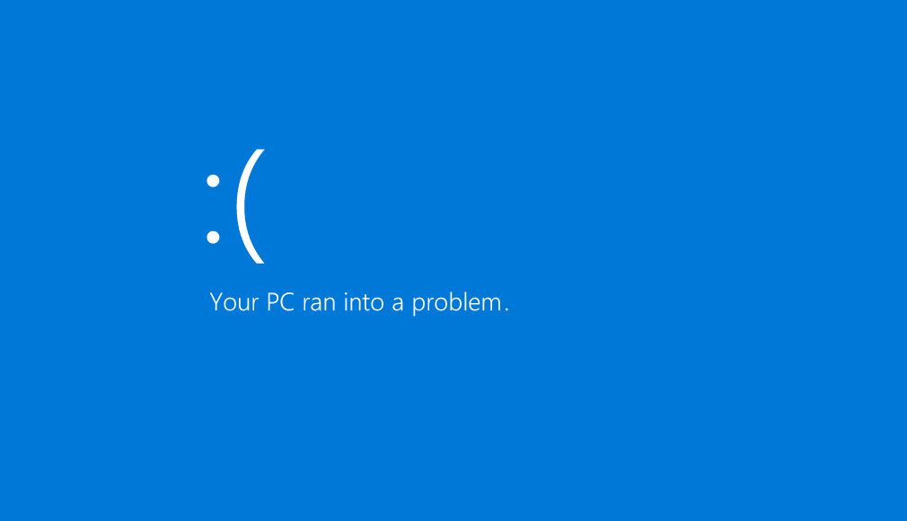
Notes:
BIG blue error.
Paul doesn’t know what to do, who to ask, and it’s a little intimidating being an employee at a big company. 4 months later

Slide 9

IT professional God.
Notes:
Hannah, the IT professional God coincidentally sees pauls error and offers help. Se teaches him how to overcome the error.
Paul feels better, Hannah feels accomplished because she could lend a hand and everything is alright.
But what if Paul didn’t have to wait 4 months?

Slide 10



Solution:
Create a web & mobile friendly app that connect employees seeking an expertise
Notes:
This is where our solution came in. We wanted to create a web application that can connect people like Hannah and paul. Basically employees are able to give and seek mentorships.

Slide 11

Who is this for?
Notes:
Who can this be for? For big companies

Slide 12
Benefits for the Company and Employees.
Free to use for employees.
Cross training between employees.
Resulting in skilled employees.
Notes:
The benefits can be fre to use for employees, cross training between employees, can result in more skilled employees. Moreover, employees can feel comfortable within the company as they have people to ask.

Slide 13

Demo Time

